Slide 1
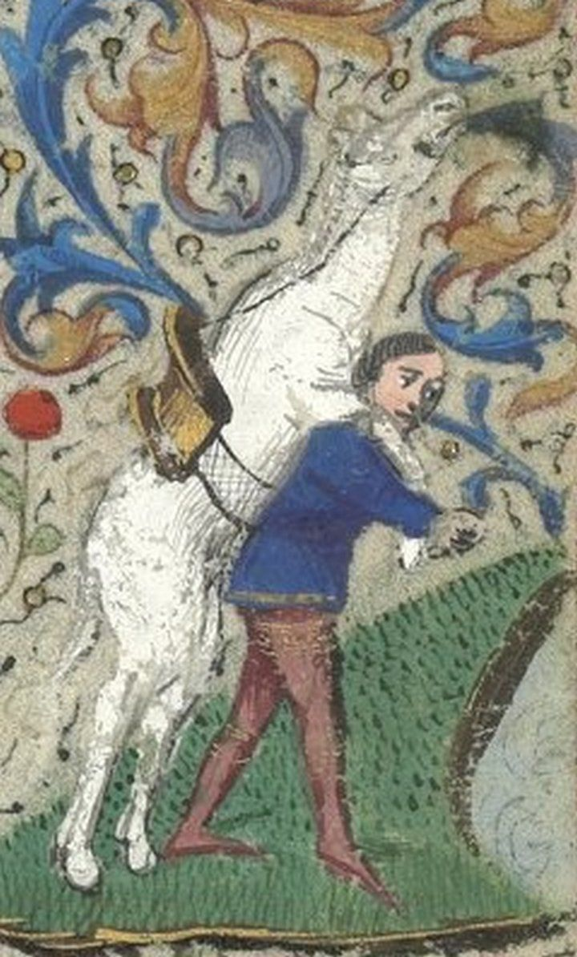
The End of the Semester is Neigh Nigh
Good Morning!
Grab a donut.
Take a handout and a course evaluation, and fill out the latter.
Note: I will not see these evaluations until your grades are submitted.
Place the evaluations in the orange envelope when you’re finished.
I will return at 9:25.

Slide 2
Notes:
Bedford Hours – Paris, 15th C
Rose Window, Notre-Dame de Paris

Slide 3
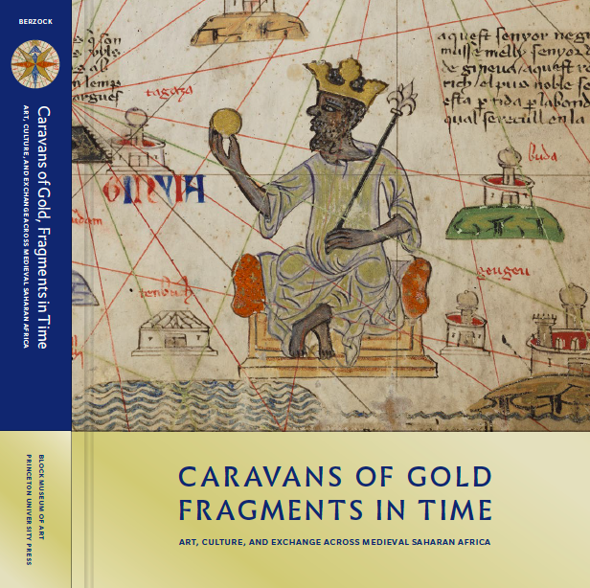
Caravans of Gold, Fragments in Time
Art, Culture, and Exchange across Medieval Saharan Africa
Journey to a medieval world with Africa at its center (700-1500).
Toronto – Aga Khan Museum
Now – Feb 2020
D.C. – National Museum of African Art
April 2020 – Nov 2020

Slide 4
Notes:
Bedford Hours – Paris, 15th C
Rose Window, Notre-Dame de Paris

Slide 5
The Black Death
Notes:
Bedford Hours – Paris, 15th C
Rose Window, Notre-Dame de Paris

Slide 6
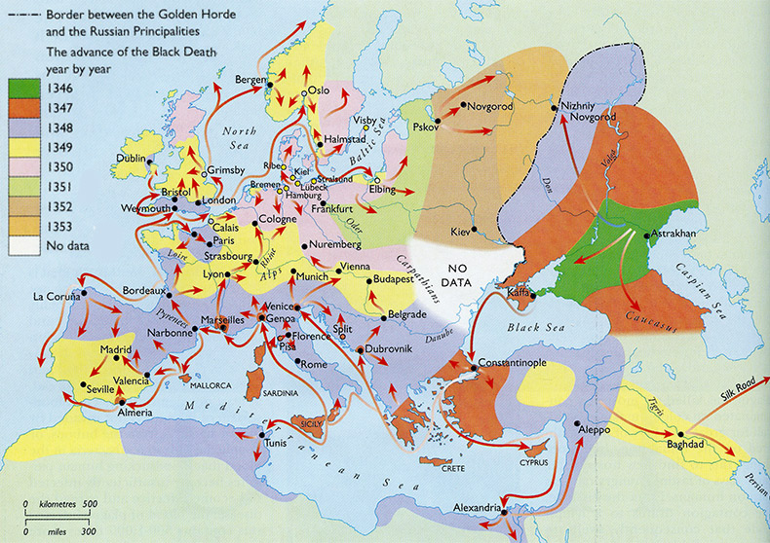
Spread of the Black Death in Europe

Slide 7
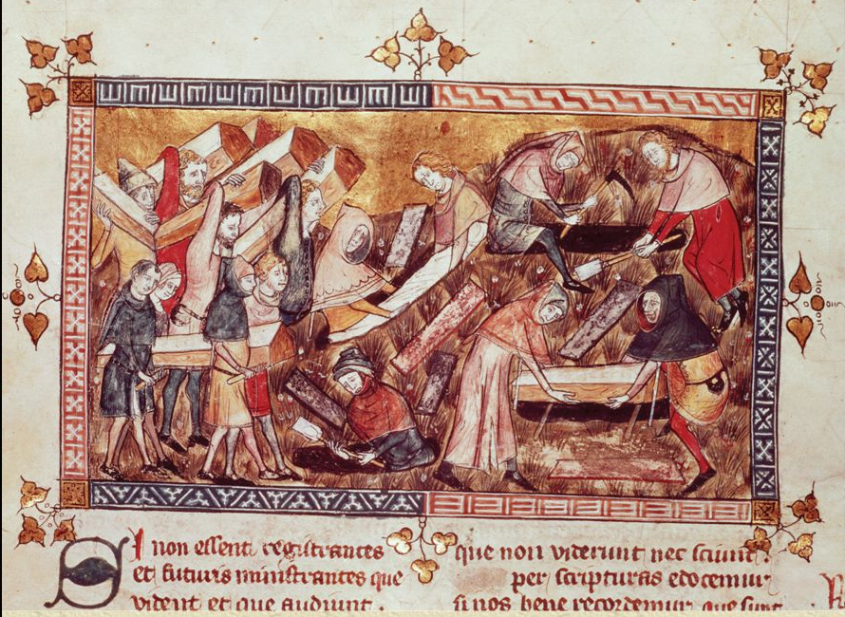
Mass Burials
Chronicles of Gilles Li Muisis (1272-1352)
Belgium, Bibliothèque royale

Slide 8
“We have said enough of these facts: that one townsman shuns another; that almost no one cares for his neighbor; that relatives rarely or never exchange visits, and never do they get too close. The calamity had instilled such terror in the hearts of men and women that brother abandoned brother, uncle nephew, brother sister, and often wives left their husbands. Even more extraordinary, unbelievable even, fathers and mothers shunned their children, neither visiting them nor helping them, as though they were not their very own.”
-- Giovanni Bocaccio, The Decameron

Slide 9
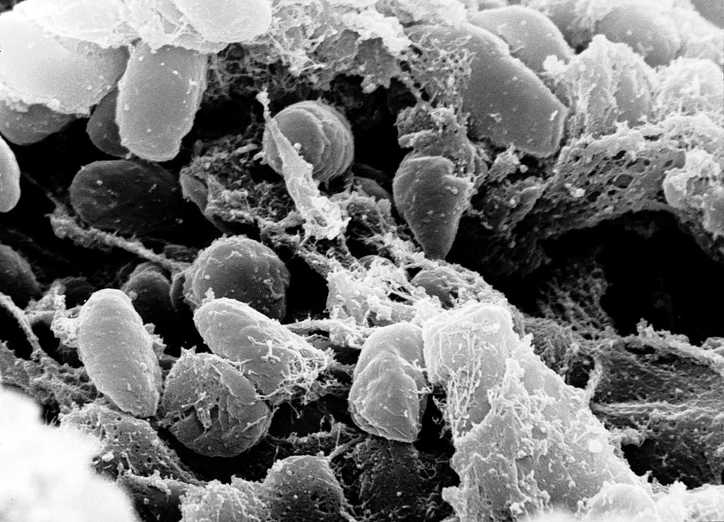
Yersinia Pestis

Slide 10
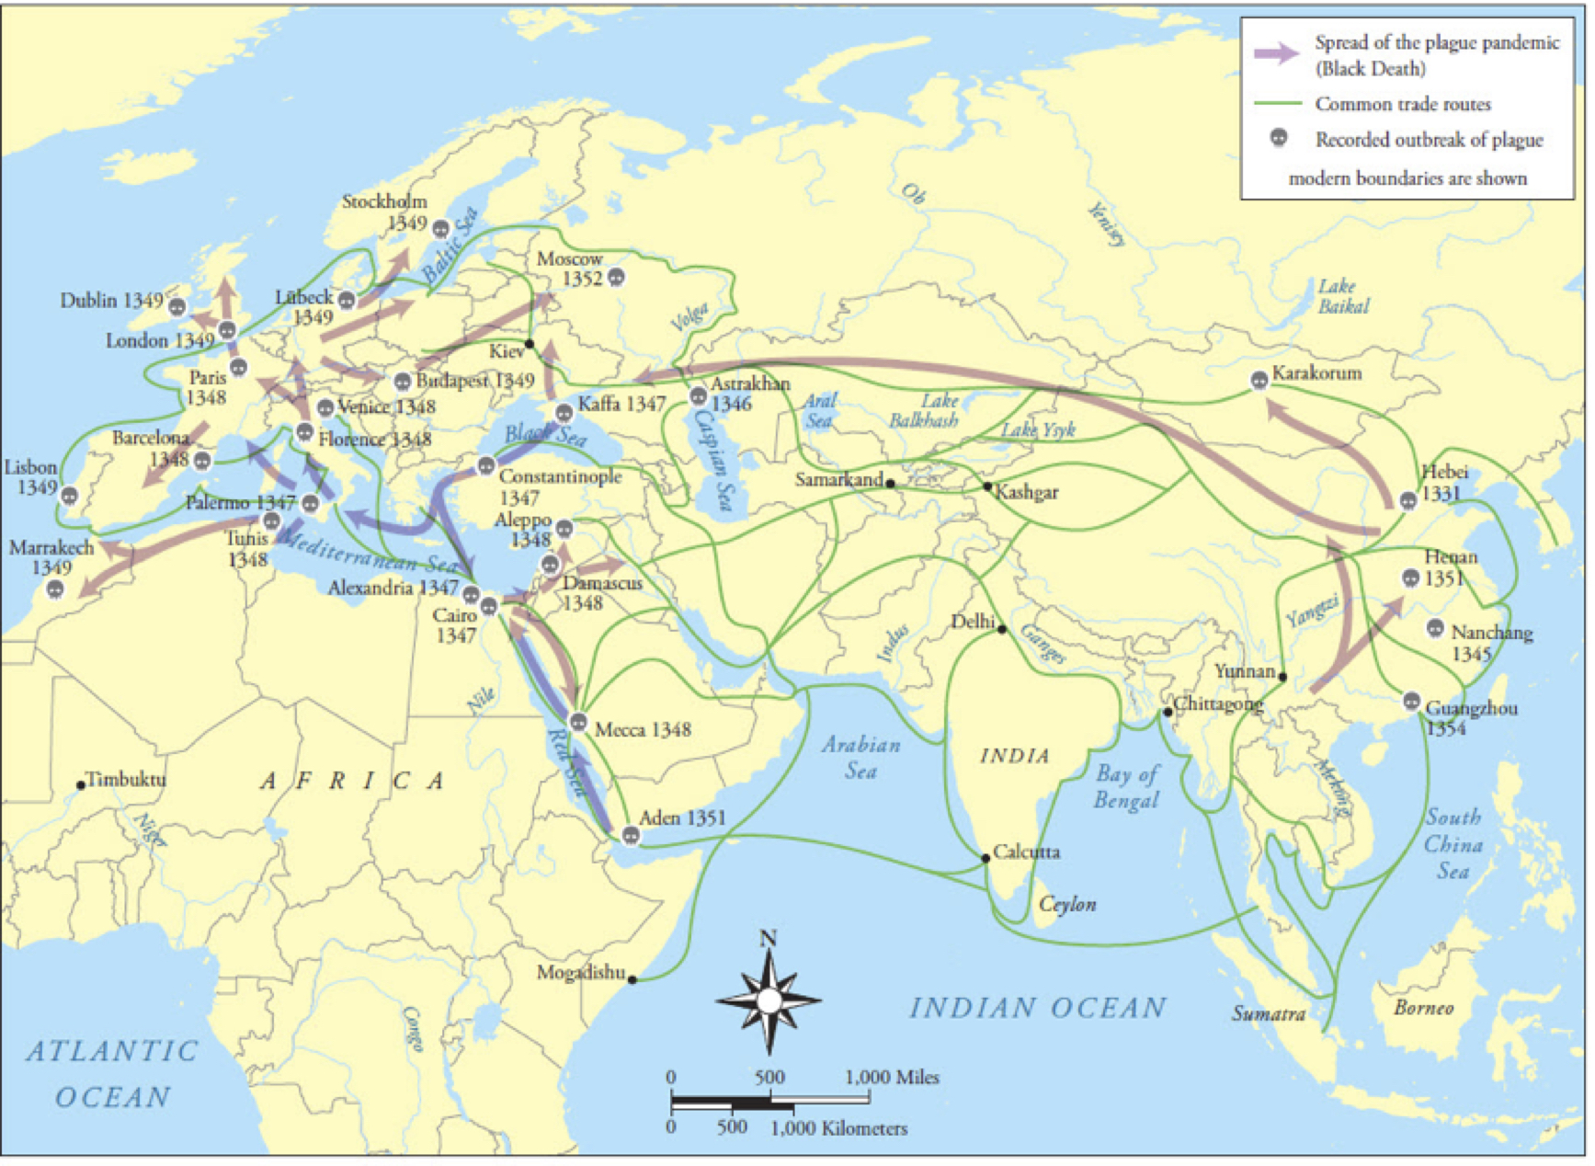
Spread of the Black Death Globally

Slide 11
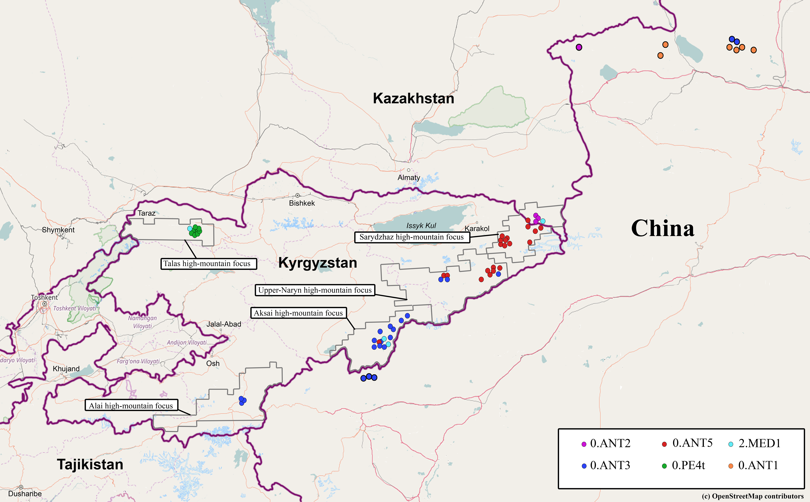
Origins in Kyrgyzstan

Slide 12
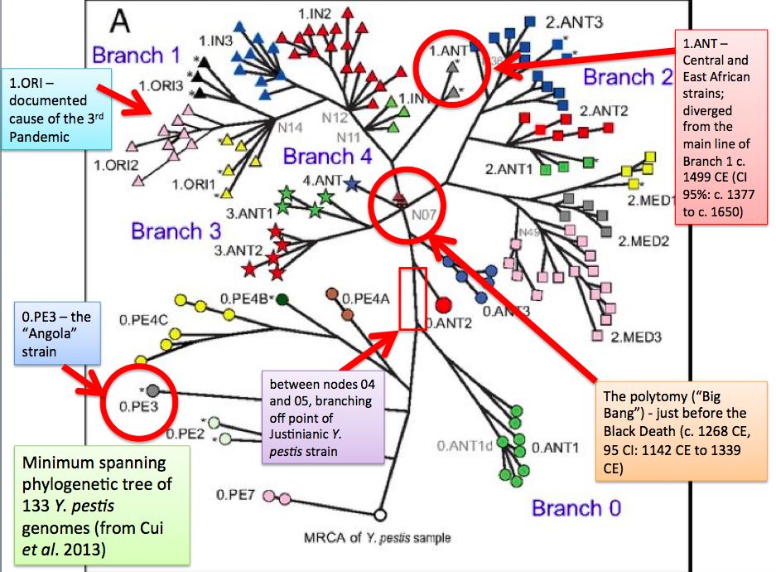
Genetic Relationships of strains of Y. Pestis

Slide 13
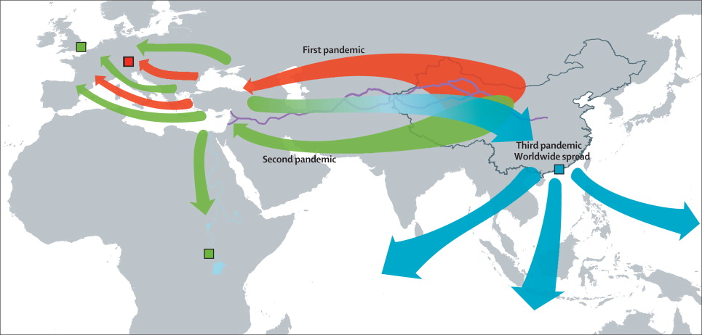
Tracing the Black Death (500s-1900s)

